Slide 1
The man who survived Cancel Culture or a Virulent Anti-Semite or both?
What can those who want to use the law to challenge anti-Zionism at work and in academia learn from the David Miller case?
David Miller was fired from his employment as a lecturer at Bristol University because he held "Zionists" responsible for funding Islamophobia, said Jewish schools are advocates for ethnic cleansing and UJS is a pawn for a violent, racist, foreign regime. Why did he win his Employment Tribunal claim? What are the underlying legal principles? Can you challenge anti-Zionist beliefs at work or academia?
By Gareth Brahams

Slide 2
How did the law end up giving this man protection from dismissal? Was it right to do so?
https://www.thejc.com/news/politics/you-use-zionism-as-cover-for-antisemitism-jacob-rees-mogg-clashes-with-disgraced-professor-david-miller-j7pwdi9j

Slide 3
Who is Gareth Brahams?
Employment solicitor, qualified in 1995
Former Chair of the Employment Lawyers Association
Tier One ranked for 12 years in Chambers and Legal 500
No involvement in the case but know lots of the lawyers involved.

Slide 4
Chronology
Commenced employment on 1 September 2018 as a professor of Political Sociology
18 February 2019, in a lecture on Islamophobia he theorised that it was driven in the UK by five pillars, one of which was the Zionist Movement
4 April 2019, a student makes a (commendably measured) complaint supporting the right of anti-Israel students and academics to express their political views in a University setting as universities are a place for debate and learning but stating that Miller’s discourse had fallen into anti-Semitism
26 June 2019, complaint rejected at faculty level on the basis that anti-Semitism means hostility to Jews as Jews (and rejecting IHRA definition) which had not at that time been adopted by the University
Autumn 2019, University does adopt IHRA definition of anti-Semitism
12 June 2020, complaint referred to Complaints Review panel who said it should be dealt with as an HR issue (in part to permit Prof Miller to participate)
20 October 2020, the Tab, the University Newspaper, publishes an article by a Jewish student about intimidation Jews feel about his teaching. He replies:

Slide 5
Miller’s response in the Tab
“The ‘hurt’ and ‘discomfort’ complained of by students, whether genuine or manufactured by campus-based lobby groups, cannot be used to prevent the teaching of the links between various political ideologies and activities”.
“He added that he believed this article was part of a series of orchestrated attacks to stop him teaching about “the important relationship between Zionism and rising Islamophobia” and amounted to “an encouragement of anti-Muslim racism”.
“Miller called the [Student Complaint] “an example of the significant number of fraudulent antisemitism complaints which have been all too common in the febrile atmosphere encouraged by supporters of the Israeli state.”
He says the complaint was rejected, and added that the UJS, who helped submit the claim, is a “formal member of the Zionist movement”.

Slide 6
Chronology continued
4 Dec. 2020
Aileen McColgan KC investigates the complaint on behalf of the University and rejects it.
13 Feb. 2021
Miller speaks at an event entitled “Building the Campaign for Free Speech”. . and some tweets in response to which Miller is called an “utterly vile anti-Semite”.
16 Feb.
more tweets and comments made to the JC and Jewish News by Miller
17 Feb.
JC reports that he said Jewish Students are Israel’s pawns
18 Feb.
sends this email to a Jewish student:

Slide 7
Email to Ben Bloch (university student) on 18 February 2021
Ben
This is on the record: Zionism is and always has been a racist, violent, imperialist ideology premised on ethnic cleansing. It is an endemically anti-Arab and Islamophobic ideology. It has no place in any society.
Bristol’s JSoc, like all JSocs, operates under the auspices of the Union of Jewish Students (UJS), an Israel lobby group. The UJS is constitutionally bound to promoting Israel and campaigns to silence critics of Zionism or the State of Israel on British campuses. This campaign of censorship renders Arab and Muslim students, as well as anti-Zionist Jewish students, particularly unsafe.
The UJS and Bristol JSoc have consistently attacked me with a campaign of manufactured hysteria for two years, attempting to have me sacked. The campaign reached new heights of absurdity when a Zionist activist pretended to be a student in one of my classes for which she was not registered, expressly for the purpose of political surveillance.
This is an age-old Israel lobby tactic imported from the US, where academics are routinely harassed for teaching about Zionism and its effects. To be clear, this campaign of censorship, which has attacked British universities, political parties and public institutions, is directed by the State of Israel. Any similar attempt by another racist, militaristic foreign regime -- such as Israel’s allies in Saudi Arabia or the UAE - to decide what is taught and who is employed in British universities would be laughed out of the room. Israel and its advocates deserve the same treatment.

Slide 8
Chronology continued…
18 February 2021: there is a media storm and a storm on campus from all sides – some pretty injudicious comments on both sides. Robert Jenrick, as relevant minister weighs in.
20 February 2021: Miller writes in Electronic Intifada – “We must resist Israel’s war on British Universities”
26 February 2021: Uni appoints emeritus professor Banting to investigate statements made in February 2021
28 May 2021 Aileen McColgan completes her second report. Again concludes no formal case to answer. Concludes statements are not anti-Semitic or discriminatory.
Banting concludes there is a case to answer about whether University policies have been breached.
Prof Norman, Dean of the Faculty appointed to conduct disciplinary process.
Prof Norman concluded Prof Miller should be dismissed on 1 October 2021 for gross misconduct and therefore without notice. Letter to Ben Bloch was key reason for dismissal as was reference to Jewish students being political pawns.
Lost his internal appeal against dismissal on 23 February 2022
Filed claim at the Employment Tribunal on 25 February 2022.
On 6 August 2023, he posted this tweet:

Slide 9
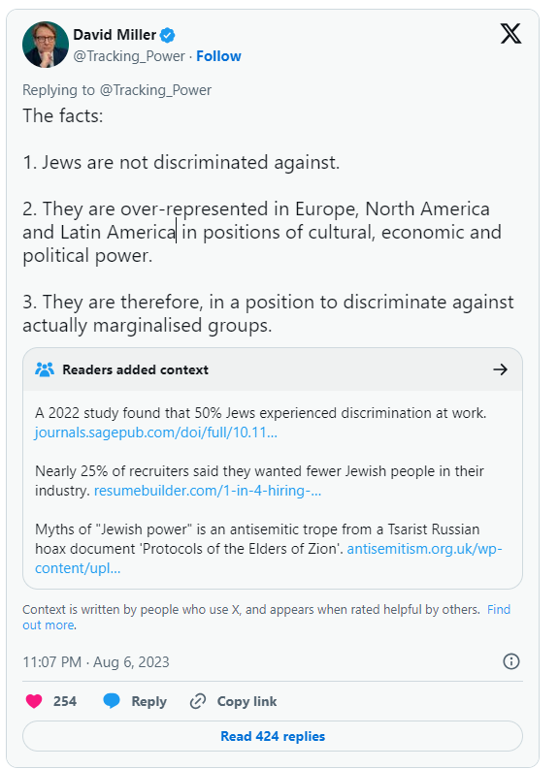

Slide 10
What was his Employment Tribunal claim?
He has a right not to suffer detriment or be dismissed due to his philosophical belief that “political Zionism” is inherently racist, imperialistic, colonial and ought to be opposed. That was infringed
  He defines Zionism as the belief that a state for Jewish people ought to be established and maintained in the territory formerly comprising the British Mandate of Palestine.
  He also in evidence said it was settler-colonial and ethno-nationalist, necessarily called for the displacement and disenfranchisement of non-Jews in favour of Jews and is therefore bound to lead to apartheid, ethnic cleansing and genocide in pursuit of territorial control and expansion
He suffered harassment for his beliefs in the form of the complaints he received, being subjected to disciplinary processes and the failure of the university to defend him
Wrongful dismissal – i.e. he was contractually entitled to notice
Unfair dismissal

Slide 11
What did the ET actually find?
His dismissal was unlawful discrimination on the grounds of religion and philosophical belief
His dismissal was unfair and in breach of contract
He was not harassed
His compensation for unfair dismissal was halved because he contributed to his own dismissal
Had he remained employed, there was a 30% chance he would have been dismissed lawfully for his social media tweets

Slide 12

What beliefs are protected by law?
Equality Act 2010 states:
Religion and belief are protected by the Equality Act 2010
Belief means any religious of philosophical belief and a reference to belief includes a reference to a lack of belief.
Granger v Nicholson (involving ethical veganism) says a philosophical belief means:
A belief, not just an opinion or viewpoint
It relates to weighty and substantial aspect of human life and behaviour
It has a minimum level of cogency, seriousness, cohesion and importance
Is worthy of respect in a democratic society and not incompatible with human dignity and not in conflict with the fundamental rights of others
A belief must be genuinely held
Religion means and a reference to religion includes a reference to a lack of religion

Slide 13
Was anti-Zionism a belief or was it an opinion for David Miller?
UoB said it was an opinion based on research
Miller said:
  It was a life-long belief
  He was not open to having his mind changed
  His research was done to back up his belief
ET said it does not need to be a touchstone.
To the unreligious, it is at least ironic that the less rational a belief is and the less open to changing it someone is , the more likely it is to be protected…
To the religious Jew, it might seem odd that a provision designed to protect them, is being used by to attack a belief held by most Jews

Slide 14
Is Anti-Zionism worthy of respect in a democratic society
Anti-Semitism is not, but the University conceded that the beliefs held were not anti-Semitic in light of Aileen McColgan’s conclusions.
ET accepted that Prof Miller was not open to violence as a means to opposing Zionism
According to Forstater (a gender critical case)
“Only beliefs that would be an affront to convention principles in a manner akin to that of pursuing totalitarianism or advocating Nazism or espousing violence and hatred in the gravest of forms, that should be capable of being not worthy of respect in a democratic society. Beliefs that are offensive, shocking or even disturbing to others, and which fall into the less grave forms of hate speech would not be excluded from the protection. However, the manifestation of such beliefs may, depending on circumstances be justifiably restricted under article 9(2) or 10(2).
  .

Slide 15
Art 10(2) is the qualification on right to freedom of expression
    The exercise of these freedoms, since it carries with it duties and responsibilities, may be subject to such formalities, conditions, restrictions or penalties as are prescribed by law and are necessary in a democratic society, in the interests of national security, territorial disorder or crime, for the protection of health or morals, for the protection of the reputation or rights of others, for preventing the disclosure of information received in confidence, or for maintaining the authority and impartiality of the judiciary

Slide 16
Can you draw a distinction between belief and manifestation of belief?
E.g. The problem is not that he is Jewish, it is that he wears a kippah; It is not that he is an anti-Zionist, it is that he makes anti-Israel statements in his lectures
Higgs v Farmor’s School
Employee shared posts to about 100 friends which referred to "brainwashing" children and "suppressing Christianity and removing it from the public arena”. Posts related to PHSE lessons regarding relationships that taught homosexual relationships had equal validity to heterosexual ones.
Eady P: “If the claimant’s actions have a sufficiently close and direct nexus to an underlying religion or belief, such that they are properly to be understood as a manifestation of that religion or belief, any limitation would need to be such as is prescribed by law and necessary, in one of the ways identified under article 9(2)” ECHR which says
“Freedom to manifest one's religion or beliefs shall be subject only to such limitations as are prescribed by law and are necessary in a democratic society in the interests of public safety, for the protection of public order, health or morals, or for the protection of the rights and freedoms of others”

Slide 17
Was Miller manifesting his belief legitimately or did he go further?
Dismissal letter focused not on beliefs but the intemperate and imbalanced ways they were expressed and how links were drawn between Jsoc, Jewish students, Zionism and Israel whilst stating Zionism was a racist, colonial, imperialistic ideology, e.g., saying members of J-Soc were “pawns” of a racist foreign regime.
ET concluded “manifestations of the Claimant’s belief were writ large in the February 2021 statements”

Slide 18
Did the University’ approach comply with s9(2)/s10(2) ECHR?
  UoB was following its policies so the action was prescribed by law
  There was a legitimate aim
    to protect those holding other beliefs; and
    the University’s reputation (not to counter discrimination, because there was none)
  Was it proportionate?
    There was significant harm to UoB’s reputation and impact on donations.
    To communicate in the way he did with students “and bring students and JSoc front and centre” was extraordinary and ill judged
    Agreed that there was an imbalance of power between a professor and their students
    Comments were made related to legitimate areas of academic research
    Concerned about chilling effect of decision on freedom of speech within an academic institution of dismissing a lecturer for his utterances
    Concluded Claimant should have been given a final written warning not to involve students in and student societies I his public comments
    Accordingly, claim that Banting’s decision to move case to a disciplinary hearing was harassment failed.

Slide 19
Would Miller have been fired anyway?
He agreed his subsequent actions were not a product of being freed from constraints of employment
Tweet from 6 August about anti-Jewish discrimination being non-existent was not targeted at students
He later accepted/clarified in a tweet that:
  Jews were disproportionately the subject of hate crime
  “well represented” rather than “over represented” would have been better terms to use
Had he had a warning, he may have chosen his words more carefully
Tribunal concluded there was a 30% chance of dismissal happening

Slide 20
What now?
The University of Bristol has been granted leave to appeal
Appeals can only deal with issues of law, not fact (unless findings are perverse)
So UoB cannot resile from their position that Miller was not anti-Semitic – which is where this all really went wrong
Appeal will be on whether the law re connection between belief and manifestation of belief was applied correctly
If the appeal is successful, religious Jews may regret the wider implications.

Slide 21
What does this mean for those who want to challenge anti-Zionism
The case is first instance (not appellate) so not binding on other Employment Tribunals
The obvious battle (that anti-Zionism is anti-Semitism) was conceded by the University. It can be fought in the next case
The importance of academic freedom and freedom of speech would not receive the same emphasis in a non-academic environment
The battle can still be fought and won in the workplace
Remember, Zionists could just as likely be in the position of seeking the protection of the law, as trying to limit it, so ironically, an attempt to save this case on appeal may make the law, overall, worse for Jews, not better.

